Slide 1
QA survey
BY:
G.Sai teja(038)
r.Sai nath(040)

Slide 2
Content:
Introduction
Objective
Requirements
modules

Slide 3
introduction
It is an online survey application, enabling users without coding knowledge to develop publish, and collect responses to surveys. Surveys can include branching, custom preferred layout and design, and can provide statistical analysis of survey results. Surveys can be either publicly accessible or be strictly controlled throught the use of tokens for survey participants. Results can be made anonymous, be separation of data.

Slide 4
objective
The idea is to allow users to quickly create intuitive, powerful, online question and answer surveys that can work for thousands of participants.
Requirements: PHP
Apache HTTP Server 2.2
MySQL

Slide 5
hardware requirements
Windows XP Service Pack 2+, Windows Vista, Windows 7, Windows 8, or Windows 10
An Intel Pentium 4 processor or later that's SSE2 capable
350MB of free disk space
512MB of RAM

Slide 6
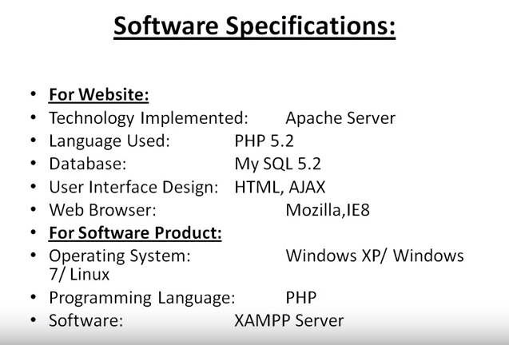

Slide 7
modules
Login page
Catogories
Surveys
Thank you

Slide 8
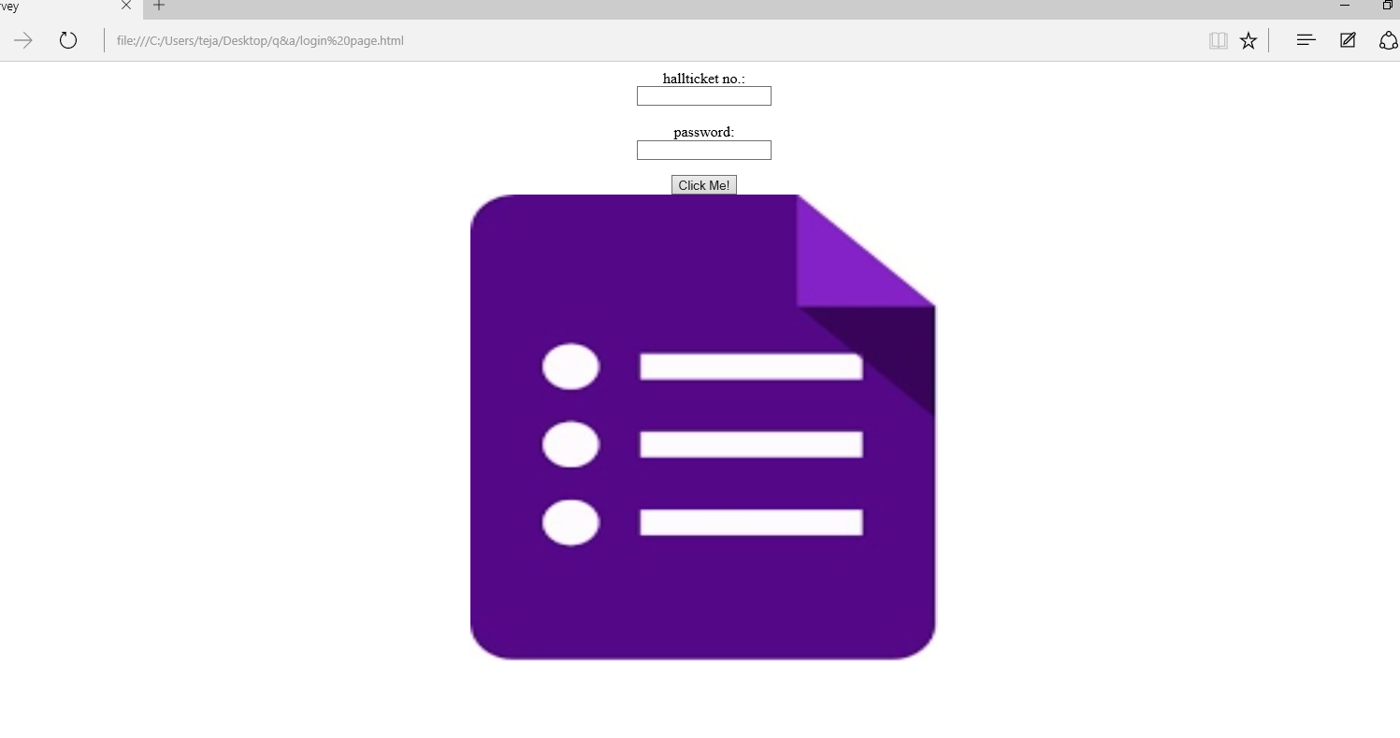
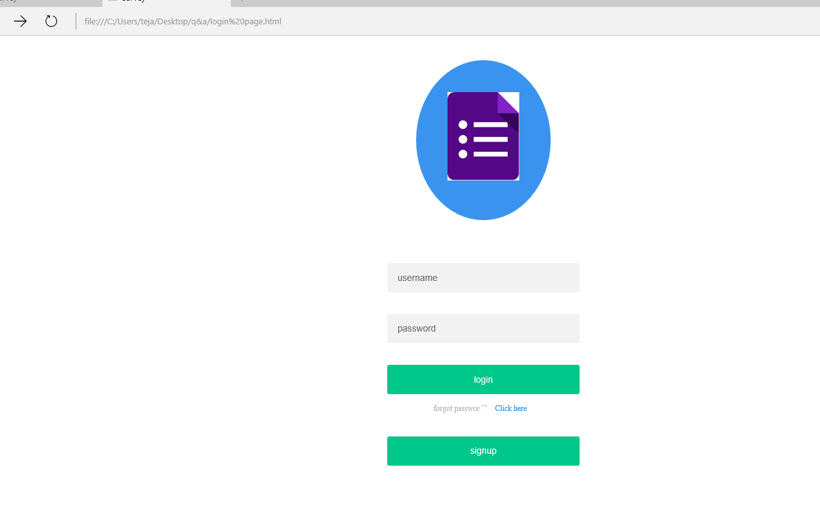
Home page

Slide 9
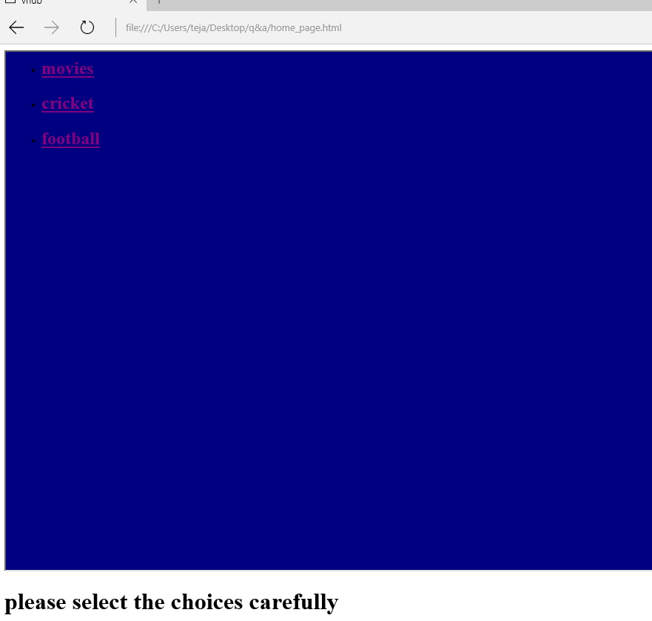
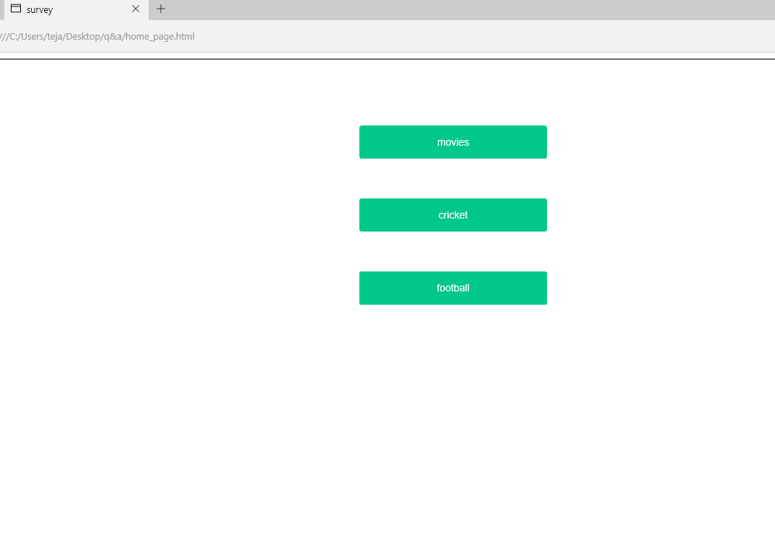
catogories

Slide 10
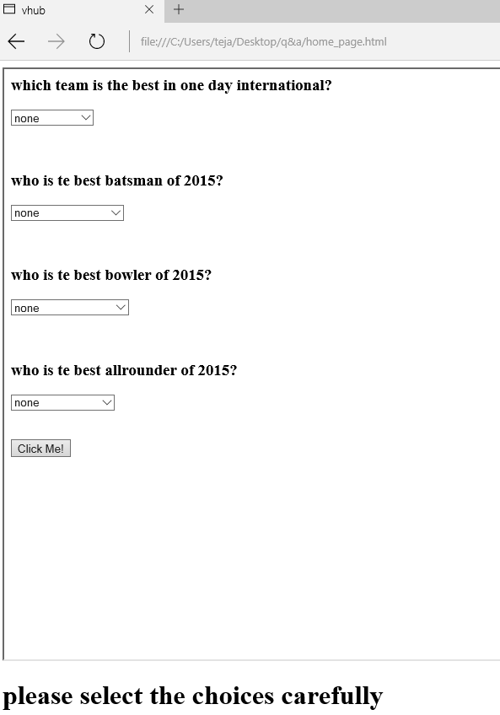
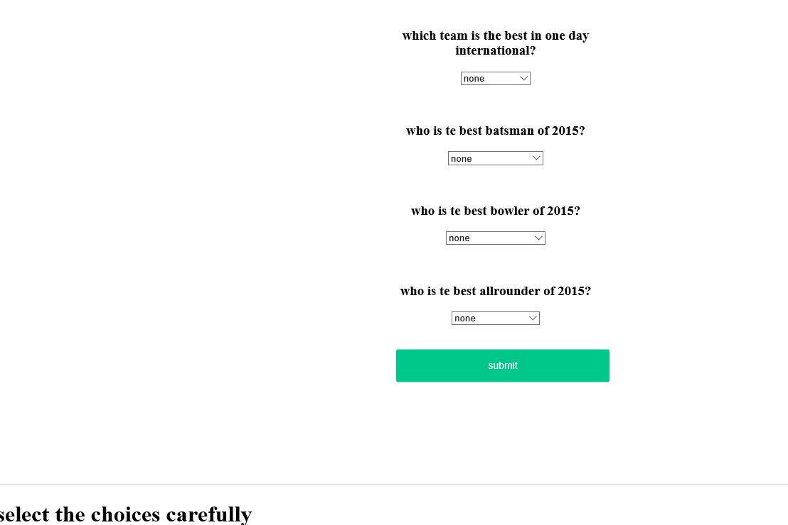
surveys

